Slide 1
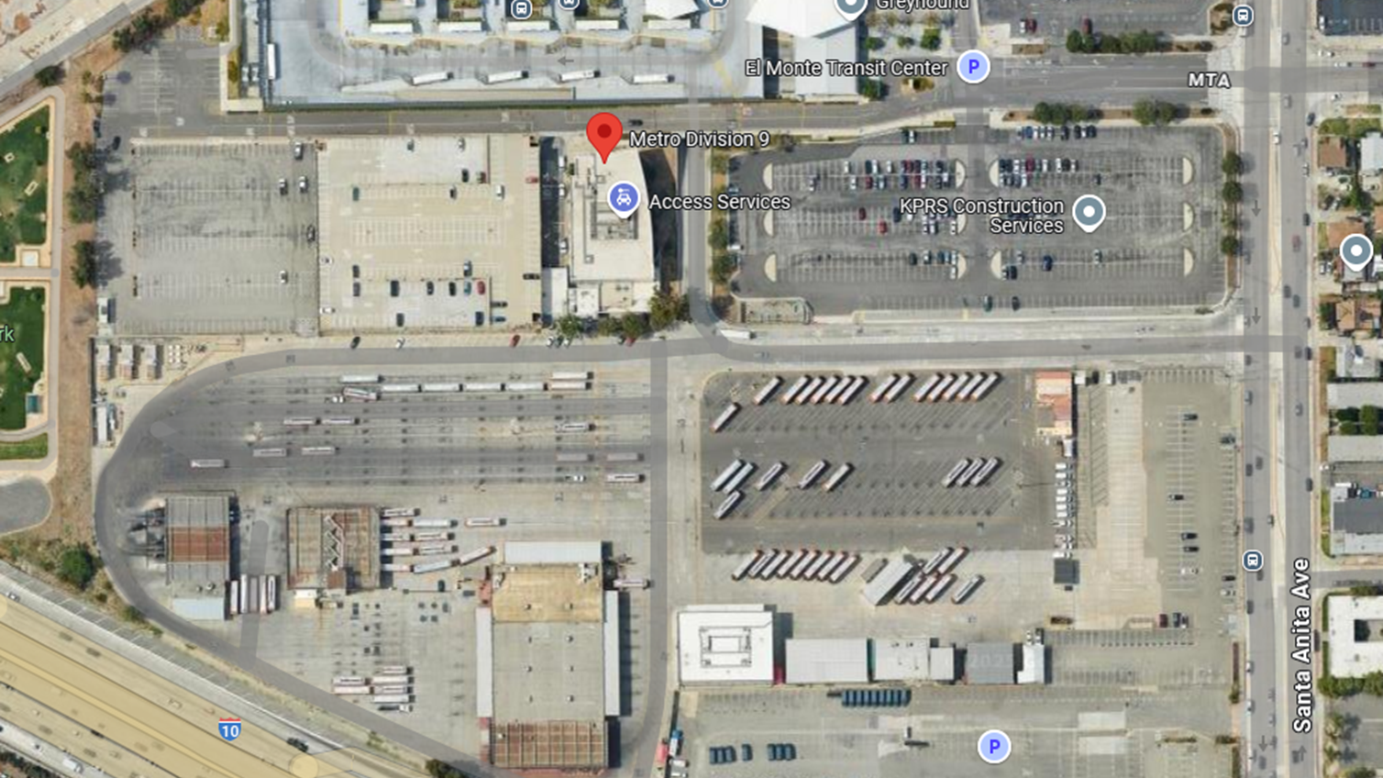
Site/Civil Layer
MV
Charger Trench
MV
Landscape
Parking Pavement
HV
MV
MV
CMV
Sidewalk
MV
HV Trench
CMV
CMV
CMV
CMV
MV Trench
Charger Trench

Slide 2
Electrical Layer
500-650kW OH Charger
Pantograph
1 MWh Battery
250 kWh Battery
Utility Connection
1
X
2 MW Charger
50-75kW Charger
1
1
1
1
125-180kW X3 Charger
1
1
1
2
480V Panel
HV-DV Xformer/SG
Pantograph
Standard Dispenser
125-180kW 1X Charger
Reel Dispenser

Slide 3
Solar Layer
Solar Canopy Type 2
Solar Canopy Type 1
OE MVC
OE MVC
OE MVC
OE MVC
OE MVD
OH Elect MV Charger
OH Elect MV Dist
Notes:
Solar Layer

Slide 4
Vehicle Layer
40’ Transit Bus

